Slide 1
Alcohol, Tobacco & Other Drugs a lesson from iknowmine.org Version 1.0
Notes:
*Note: Statements that are italicized and underlined are lesson directions and directions for you as an educator and for reference only. You can consider all regular text a script.
Welcome the students in your class, introduce yourself and whoever else may be assisting with the lesson. Hand out the “Presentation Worksheet” to each student.
Welcome to today’s lesson about Alcohol, Tobacco & Other Drugs. We will use the website iknowmine.org to learn more about the topics. IKM is a youth wellness website designed for Alaska Native youth. For the next hour, we are going to learn about how different substances interact with the teenage body and brain, different types of substance use disorders, and where to find help around substance misuse. We’ll do this by having a brief lecture followed by a couple of activities using iknowmine.org. I’ve given each of you a worksheet, please use this activity as your notes for today’s lesson.

Slide 2
Grounding Activity
Sit with back straight and eyes in front of you
Put both feet flat on the floor
Close your eyes
Focus on your breathing
Notes:
Today we will be discussing things like Alcohol, Tobacco, and Other Drugs, and topics related to substance use. Some of the things we talk about can be sensitive and may cause strong feelings of emotions. To work through this I want to start by doing a quick grounding activity. This activity is meant to calm your heart and mind and bring your attention back to our discussion. If at any point during this lesson you feel your mind wander or you become uneasy, you can do this activity to help focus and bring your attention back to the lesson.
Grounding Activity
Sit with your back straight against the back of your chair and focus your eyes in front of you. Put both feet flat on the floor and place each hand on the top of your legs, palms down. Close your eyes. We will now focus on our breathing. Breathe in slowing for 3 seconds (1…2…3…) Bring your mind’s focus on your body, how does your body feel sitting in the chair? What does the chair feel like under you? What does the floor feel like beneath you? Can you feel the energy flowing through your hands to the rest of your body? Remember to keep taking deep breaths. Next, while still sitting, push your feet into the ground, imagine the energy-draining down from your mind, down through your body, and out through your feet into the ground. As the energy drains from your mind, feel how heavy each body part becomes, your torso feels heavy and now your arms as you relax those muscles. Lastly, feel the heaviness go down your legs, through your feet and down into the ground. Now that we have calmed our energy and grounded ourselves, slowly open your eyes and come back to the present.

Slide 3
Group Agreements
In our conversation, we want this room to be a space where:
Everyone feels safe to share
Differences of opinion are okay
Privacy is protected– no one should feel like they have to talk about things they don’t want to talk about
Discuss mandatory reporting
There is no need to share personal stories
We use self care (step out if you need to)
What would you like to add or change?
Notes:
If you have the resources, feel free to write group agreements on dry erase board or poster board before the lesson.
Before we begin today’s lesson, let’s make some group agreements.
Please no sharing of personal stories. Instead, say “I have a friend that…,” or, “I’ve seen this in my community...”
Practice self-care. If you need to, step out in order to gather yourself, just know that we will follow you just to make sure you're okay.
This is a safe space and we will all ensure confidentiality. When people share private information in this group, it should be kept private. I’ve asked you not share personal stories, but if the discussion happens to reflect a personal situation or if someone does share a personal story, it is important that we all agree to keep it in this classroom.
This would be a good opportunity to also talk about us facilitators as Mandatory Reporters:
Say: As a Mandatory Reporter, it is my legal responsibility to report any time we hear of a minor being hurt by others or if we hear that they are going to seriously harm themselves or others. This is a federal law, and it exists to protect young people. Although I am a mandatory reporter, I want you to know that I am a safe person to talk to, and I hope that you can feel comfortable and safe talking to me.
Show respect for others, even if you disagree with them. If someone says something that you disagree with, it would be a violation of the Group Rules to say, “That’s stupid,” or “You’re wrong.”
Be supportive of each other. Protect others’ feelings and know that some of these topics can be very sensitive.
Ask: ss there anything else anyone would like to add?

Slide 4
Our Words Matter
How we talk about substance use and overdose can impact how we think of, and treat, other people.
An individual should not be defined by their substance use, but by their whole being.
Junkie, Addict → Person with Substance Use Disorder
Addicted to X → Has an X use disorder
Notes:
Today we will be going over sensitive topics and information related to substance use. As we just discussed we want this to be a space where everyone feels safe to share. It is important to recognize that language can be very powerful, especially when discussing alcohol and other drugs and the people who use them.
Stigma is a mark or disgrace or honor on somebody because of the choices they have made. The negative stigma associated with substance use is typically portrayed through negative language, reinforcing stereotypes and hindering care. Stigmatizing language is harmful to an individual using substances and limits compassion from loved ones and care providers.
In today’s classroom, we will be using neutral and caring language. Referring to individuals who use substances as “junkies” or “addicts” is not only disrespectful but also portrays that individual in a negative light. Instead of using negative words try to use phrases that are people-first such as “person who uses substances” or “person with substance use disorder”
*Supplemental material “Language Matters” found on iknowmine.org’s resources page can be used to further explore why language matters and words to use and avoid.

Slide 5
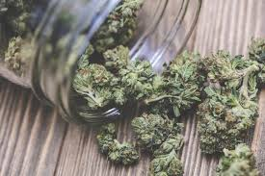
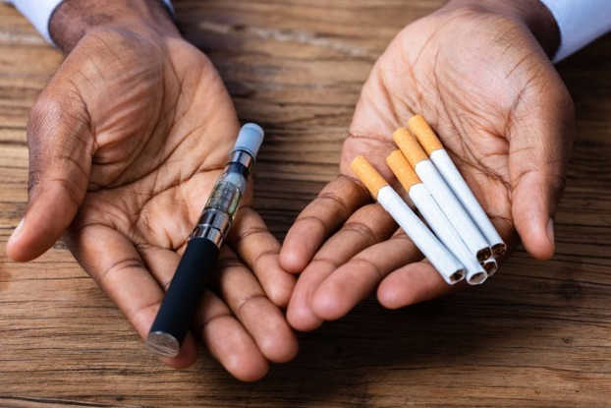
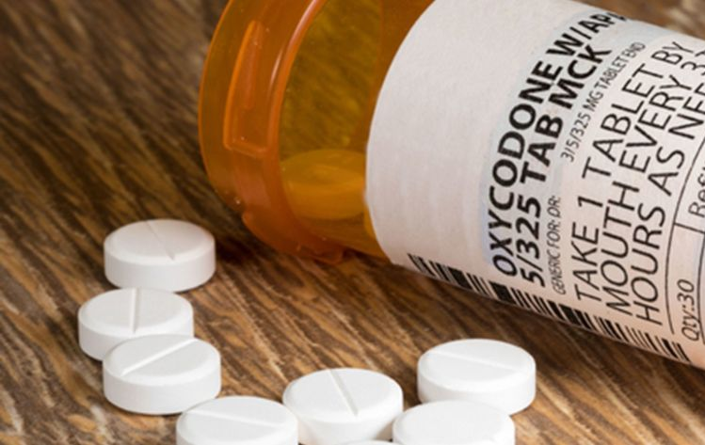
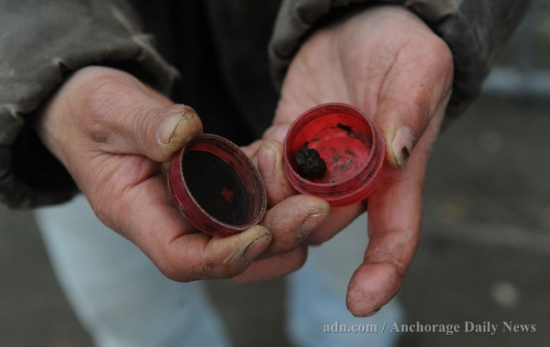
Substances: The Basics
“Stimulants” and “depressants” are the two main kinds of substances (AKA uppers and downers)
Notes:
Let students know that they will have an opportunity to learn more in depth about the various kinds of substances in an activity later on, after the presentation. We will explore information using iknowmine.org about the following: “Alcohol”, “Tobacco”, “Marijuana”, “Prescription Opioids”, “Heroin”, “Cocaine”, “Methamphetamine (Meth)”, “Hallucinogens”, “Spice”, and “Inhalants” provide further information on background details, signs of use, and consequences of use. Example of use: Read the front of postcard to class then pass around for students to read and explore further.
A substance is a type of product that has the power to change the chemistry of a person’s brain and in turn, change bodily functions. This can include alcohol, tobacco, and even caffeine
Have class list out other examples of substances they may be familiar with.
Different substances can be categorized into two types: stimulants and depressants.
Stimulants, sometimes called “uppers,” are substances that increase alertness and energy while also causing some other very serious side effects that we will talk about shortly. Examples of stimulants include caffeine, cocaine, and methamphetamines.
Depressants, sometimes called “downers,” depress the central nervous system of the brain causing multiple effects such as a slowed heart rate and slowed or stopped breathing. Examples of depressants are prescription opioids, alcohol, marijuana, and heroin.
People often use more than just one substance. This is called polysubstance use.
See the full list of substances covered below.
-Alcohol– such as hard liquor, wine, and beer
-Tobacco– a naturally found plant that is grown to make products such as chew, dip, cigarettes, e-cigarettes, vaping, and Iqmik
-Marijuana– a naturally found plant that can be used by vaping, smoking, or consuming edibles
-Prescription Opioids– such as pain relief medication prescribed by a doctor
-Heroin– an illegal type of opioid that is injected sniffed, or snorted
-Cocaine– a white powder or a crystal rock substance made from the leaves of the coca plant
-Methamphetamine (Meth)– a white powder or rock that stimulates the brain
-Hallucinogens– pills or liquids that alter a person’s awareness and creates hallucinations
-Spice– a mix of natural herbs and laboratory chemicals that cause mind-altering effects
-Inhalants— which are common household chemicals that are inhaled

Slide 6
Substances: The Body
Here are a few examples
Alcohol can cause liver and heart damage and increase risk for cancer and other diseases
Tobacco increases risk of lung and heart disease, yellowing of teeth and skin
Prescription Opioids/Heroin can cause confusion and nausea while also slowing or stopping heart rate and breathing
Cocaine can lead to nasal damage, loss of smell, and damage to the intestine
Notes:
Using substances can affect almost every system in your body. Long term substance use can cause or worsen health problems like cancer, heart disease, lung disease, liver function, and mental disorders. How people use substances can lead to infectious diseases like HIV, hepatitis, and tuberculosis. Some of these health issues occur when drugs are used in high doses for long periods of times, however, each person and substance is different, therefore health consequences can occur after just one use.
Substances can alter the body in many different ways, here are a few examples:
Alcohol can lead to liver damage, cardiovascular disease, and multiple types of cancer
Tobacco in any form can harm several organs in the body, causing cancer, stroke, heart disease, and lung problems
Prescription Opioids, when not taken as directed by your doctor, can cause slowed or stopped breathing, unresponsiveness, and death from overdose
Cocaine can lead to nasal damage, loss of smell, damage to the intestines, weight loss, and lung damage
Inhalants can cause muscle spasms, tremors, trouble walking and talking, and can cause difficulty when trying to learn new things

Slide 7
Substances: The Brain
Neurons
Pleasure
Emotions
Send wrong messages
Makes it hard to feel happy
Cause poor judgement and decision making and slows learning
Mimic the brain’s natural chemical messengers
Overstimulate the “reward circuit” of the brain
Change in feelings and moods
Substances change the brain, making substance use compulsive or uncontrollable
Notes:
The human brain continues to develop until a person is about 22-25 years old. Using substances while the brain is still developing can cause serious, non-reversible effects in the brain. There are three big ways that substances can affect the brain, 1) by attacking neurons, 2) by overstimulating, and 3) by crossing circuits and changings emotions.
1) Neurons:
Drugs are chemicals. When someone puts these chemicals into their body, either by smoking, injecting, inhaling, or consuming them, they make their way into the brain’s communication system and change the way nerve cells normally send, receive, and process information. Different substances– because of their different chemical structures—change the brain in different ways. Some depressants, like marijuana and heroin, have chemical structures that mimic our body’s natural neurotransmitter. They do this by pretending to be our brain’s receptors and activating a nerve that shouldn’t be activated. Because they are “fake” neurotransmitters, they are able to send wrong messages from the brain to the body.
Stimulants, such as cocaine and methamphetamine, cause nerve cells to release the wrong amount of dopamine, changing the stimulation of nerves. This causes mixed messages to be sent in the brain and blocks communication. An example of this would be having someone whisper in your ear but it sounding like someone shouting in a microphone.
2) Pleasure:
Our brains are wired to make sure we will repeat survival activities, like eating, by connecting those activities with pleasure. Whenever this reward circuit is kick-started, the brain notes that something important is happening that needs to be remembered and teaches us to do it again and again without thinking about it. A common example of this is when you feel hungry your brain tells you to eat, which tastes good and makes you full and happy. Because substances “hijack” this pleasure circuit, the brain remembers to and wants to continue using those substances in the same way it remembers to eat food.
After repeated substance use, the brain starts to adjust to the increase of “fake” dopamine by making less real dopamine. As a result, it is harder to feel pleasure. When this happens, a person feels sad, depressed, and is unable to enjoy things or activities that use to make them happy. Now, in order for a person to feel that same happiness again, a continued or higher dose of the substance must be used.
3) Emotions:
In addition to actually changing the way the brain communicates with the rest of the body, substances can cause sudden mood changes– like going from extreme happiness to feeling frustrated and angry. Substances can also cause miscommunication in the brain when it comes to judgment, making a person do, say, or act in a manner they wouldn’t usually.
All substances can cause serious changes in your brain even after just one use.

Slide 8
Categories of Substance Use
Substance Use Disorder is a disease that affects a person’s brain and behavior leading to an inability to control the use of a substance despite the harmful consequences.
Substance Use is when someone consumes substances. Substance use always comes with a risk of developing a Substance Use Disorder.
Substance Misuse is when a person consumes substances, despite the fact that they are causing issues in their life.
Recovery is a process of change through which people improve their wellbeing by overcoming a Substance Use Disorder.
Notes:
The “Substance Use, Misuse or Disorder” Postcard can be used during this slide to talk more and discuss the types of substance use.
Now that we know how substances impact a person’s body and change brain function, we are going to learn about substance use disorders, which are various medical conditions that affect when and how much of a substance a person uses.
Substance Misuse, Dependency, and Addiction are all types of Substance Use Disorders. Substance Use Disorders are diseases that affect a persons’ brain and lead to an inability to control the use of legal or illegal drugs or medication despite any harmful consequences. People with Substance Use Disorders sometimes develop a tolerance for a substance, which means they need larger amounts to feel the effects (to feel pleasure, or “high”), they can become addicted, meaning intensely craving a substance despite the consequences, and they can also experience withdrawal symptoms when trying to cut back or stop using the substance.
By Substance Use we are talking about the consumption, eating, drinking, inhaling, of any type of substance. Somebody can begin using substances for various reasons, including peer pressure, to find a sense of adventure, or because they were prescribed by a doctor. While many people can drink alcohol or use certain drugs without developing a substance use disorder, using any type of substance for any length of time creates a risk of developing a substance use disorder.
Substance Misuse is when a person uses substances regularly, despite the fact that it is causing issues in their life. Misusing substances can lead to harmful or problematic use, which is when the misuse affects a person’s health and wellbeing, such as suffering from an overdose, and injury from being intoxicated, or longer-term health issues such as liver disease. Substance misuse affects a person’s relationships with friends, family, and themselves. Issues from substance misuse can be simple, such as being late to work or missing school or complex such as blacking out and losing memories. Someone who is misusing substances may develop a tolerance for that substance—meaning they need more than previously used to achieve the same experience. People who misuse substances will continue to use them despite the consequences they cause.
Recovery is when a person who has a Substance Use Disorder changes their behaviors to improve their health by limiting their substance use. Recovery is a life-long process that encourages positive changes within a person’s lifestyle. Expecting someone to abruptly stop using substances instead of slowly decreasing their dose is not realistic. Relapsing, or using substances again after a period of not using, is a part of the recovery process and can ultimately help achieve a person achieve their goal of remission. There are many pathways to recovery. People will choose the pathway that best supports their cultural values, financial situation, their mental and behavioral needs and the nature of their substance use disorder. Options may include support groups, therapy, detox services, treatment- both in-patient and out-patient, and services that support people in responsive and respectful ways to help improve their health, relationships, and cultural needs.

Slide 9
Substance Use Disorder What does it look like?
Spending more time getting, using and recovering from substance use
Example: having to sleep longer after a night of “partying”
Continuing using substances even though it causes problems
Example: failing exams or missing family functions because of drinking too much
Needing more of the substance to get the same effect
Example: having to drink more alcohol in order to feel drunk
These symptoms can occur with the use of any substance
Notes:
Even with knowing all these definitions, it may still be hard to know who may be experiencing a Substance Use Disorder (SUD). SUDs can look different for everyone.
If somebody is experiencing a Substance Use Disorder they will usually have one or more of the following signs and symptoms:
- Spending more time getting, using and recovering from substance use
-Having to sleep longer after a night of “partying”
- Continuing using substances even though it causes problems
-Failing exams or missing family functions because of drink too much
- Needing more of the substance to get the same effect
-Having to drink more alcohol in order to feel drunk
Other signs that somebody has a Substance Use Disorder are:
- Using substances in larger amounts than they’re supposed to, like taking more of their prescription than directed
-Making efforts to stop using, but being unable to do so without help
-Having strong cravings and urges to use the substance
-Taking increased risks related to the substance, like going to dangerous places to buy or use the substance
-Continuing to use the substance even though they know its harmful
-Having withdrawal symptoms when stopping use
If a person stops using substances after their brain has developed a dependency they will experience withdrawal symptoms. These symptoms are the brain and body reacting to the lack of chemicals from the substances. Common examples of withdrawal symptoms include muscle aches, nausea, vomiting, insomnia, agitation, anxiety, diarrhea, chills, and sweating. These symptoms can occur with stopping the use of any substance(s), if the person has developed a dependency.
Ask: Can you think of signs that somebody may be suffering from a Substance Use Disorder?

Slide 10
Being Aware
Why do people use substances?
Doctor prescribed (Prescription Opioids)
Because they are bored or are pressured by their peers
To cure feelings of sadness, anxiety, stress, or other
Signs to look for:
Skipping school, trouble with law, and issues with friends and family
Weight loss, lack of regular physical activity, changes in eating habits
Alternative activities:
Participating in after school activities such as sports teams and theatre groups
Attending community and school sporting activities
Participating in cultural activities such as hunting, dancing, or cooking
Notes:
Now that we know about how substances can affect the brain and body and we have a background in the different types of substance use disorders I want to share with you a few things to remember.
People start using substances for a lot of different reasons, including health reasons. Sometimes kids and teens try drugs to fit in with a group of friends. Or they might be curious or bored. Someone may use illegal drugs for many reasons, but often because they help the person escape from reality for a while. Using a substance might temporarily make someone who is sad or upset feel better or forget about problems. But this escape lasts only until the substance affects wears off.
If someone is using illegal substances, you might notice changes in how the person looks or acts. Some signs of use might include: loss of interest in school, change in friends, becoming moody, cranky, or worried all the time, or abnormal loss or gaining weight.
There are multiple things to look for in a friend who you think might have a substance use disorder. These include:
-Getting worse than usual grades in school and/or skipping school
-Changes in normal behavior– not eating, not hanging out as much as they used to, or losing weight fast
While removing yourself from situations where people are using substances can sometimes be difficult, it is good to be aware of alternative activities to do instead and to be prepared with ideas on how you would remove yourself from the situation.
Let's take a quick minute to answer Question 9: Critical Thinking question on your worksheet.
Allow 2-3 minutes for students to respond to the worksheet question. Once all students have had time to write a response, proceed to the next slide.

Slide 11
Resources for Help What should I do if someone I know needs substance use help?
Talk to a trusted adult such as your Teacher or School Counselor
Talk with your Primary Care Provider or Behavioral Health Aide
Alaska CareLine
877-266-HELP (4357)
Text 4help to 839863
Call the National Suicide Prevention Lifeline
1-800-273-TALK (8255)
Remember, you are worthy!
Notes:
If you think somebody you know, or yourself, has a substance use disorder have them, or yourself talk with a trusted adult. This can be a teacher, a parent, your primary care doctor, a family friend, an elder, a behavioral health aid, or anybody in your community who you feel comfortable opening up to. If you need help immediately, or don’t have an adult you can talk to, you can call Alaska’s CareLine or the National Suicide Prevention Lifeline where you’ll be connected with a trained professional who is able to talk with you about multiple life issues including substance use.
Remember, you (or your friend) are worthy of care and support. No matter your choices, somebody is here to help.
Postcards can also be used as additional references for resources on access to care.

Slide 12
Scavenger Hunt
Notes:
In the absence of the internet, have students refer to, and answer the activity questions using the Substance Postcards.
Students can work individually, in pairs, or in small groups depending on the class size and number of available substances to research.
We will now do an interactive scavenger hunt using iknowmine.org or the iknowmine Substance Postcards.
I am going to assign each of you a substance, you will then go onto iknowmine.org, or used your assigned postcard, and answer the questions on the following page. You will have about 20 minutes to complete this activity. Please answer each question as best as you can, and we will report out our findings to each other at the end. If you have any questions or need help please raise your hand.
After ~15 minutes gather the student's attention and have each student, pair, or group report out on one of their findings.

Slide 13
Group Discussion
How would you help someone who might be struggling with drugs or alcohol?
What is something new you learned today?
What is something you can share with friends, family, or your community from today’s lesson?
Notes:
Have students gather into a circle, or report back to their original seats.
Before we end our class today I want to go through and do a group discussion some things we learned. I’m going to ask some questions to the group and I would really like as much participation as possible. Remember there are no wrong answers.
How would you help someone who might be struggling with drugs or alcohol?
Example: Ask a parent or adult to help you, ask a positive role model to help, connect them with resources or information such as the hotlines or websites mentioned. Challenges may include that the person doesn't know why need help or doesn’t want help.
What is something new you learned today?
Example: Any facts from presentation, worksheets or activities. Definitions of substance use, misuse, abuse, addiction, tolerance. Facts about substances, how drugs/alcohol affect the brain and body, resources for help, etc.
What is something you can share with friends, family, and your community from today’s lesson?
Example: Any facts from presentation, worksheets or activities. Definitions of substance use, misuse, abuse, addiction, tolerance. Facts about substances, how drugs/alcohol affect the brain and body, resources for help, etc.

Slide 14
Thank You!
For questions, comments, or technical assistance please contact info@iknowmine.org
This project was created by ANTHC’s HIV/STD Program and Substance Misuse Prevention Program
This project was funded in part with grant funds from the AmerisourceBergen Foundation

